Slide 1
Algorithm Design Techniques

Slide 2
Introduction
Divide and Conquer
Dynamic Programming
Greedy Approach
Branch and Bound
Backtracking Algorithm

Slide 3
Divide and Conquer
The divide and conquer technique involves breaking down a complex problem into smaller, more manageable subproblems. It follows a recursive approach where each subproblem is further divided until a base case is reached. The solutions to the subproblems are then combined to obtain the final solution.
Top- Down approach.
Example-Merge Sort and Quick Sort.etc.

Slide 4
Dynamic Programming
Dynamic programming is a technique used to solve problems by breaking them into overlapping subproblems and solving each subproblem only once. It involves storing the solutions to subproblems in a table or cache to avoid redundant computations.
Bottom-up Approach.
Example- Knapsack Problem, Fibonacci Series.

Slide 5
Greedy Approach
Greedy method is used to solve the optimization problem. An optimization problem is one in which we are given a set of input values, which are required either to be maximized or minimized (known as objective), i.e. some constraints or conditions.
Greedy Algorithm always makes the choice (greedy criteria) looks best at the moment, to optimize a given objective.
The greedy algorithm doesn't always guarantee the optimal solution however it generally produces a solution that is very close in value to the optimal.
Example- shortest path, Huffman coding.

Slide 6
Branch and Bound
These algorithms are generally used for optimization problems (problems involving finding the best solutions from the feasible ones) in which a root problem is further divided into subproblems which helps in ruling out a large number of alternatives.
Example- Travelling Salesman Problem.

Slide 7
Backtracking Algorithm
Backtracking Algorithm tries each possibility until they find the right one. It is a depth-first search of the set of possible solution. During the search, if an alternative doesn't work, then backtrack to the choice point, the place which presented different alternatives, and tries the next alternative.
Example- Sudoku

Slide 8
Dynamic Programming (Deep-dive)
We need to break up a problem into a series of overlapping sub-problems, and build up solutions to larger and larger sub-problems. If you are given a problem, which can be broken down into smaller sub-problems, and these smaller sub-problems can still be broken into smaller ones - and if you manage to find out that there are some over-lapping sub-problems, then you’ve encountered a DP problem.
The core idea of Dynamic Programming is to avoid repeated work by remembering partial results and this concept finds application in many real life situations.
Example of “1+1+1+1+1+1+1+1 =”

Slide 9
Memoization - it is memorizing the results of some specific states, which can then be later accessed to solve other sub-problems.
The intuition behind dynamic programming is that we trade space for time, i.e. to say that instead of calculating all the states taking a lot of time but no space, we take up space to store the results of all the sub-problems to save time later.
Recursion is the key concept for dynamic programming.

Slide 10
Fibonacci Example
Consider the following recurrent definition of Fibonacci numbers:
CODE 1
Using Dynamic Programming approach with memorization we define the following code: CODE2
void fib () {
fibresult[0] = 1;
fibresult[1] = 1;
for (int i = 2; i<n; i++)
fibresult[i] = fibresult[i-1] + fibresult[i-2];}
int ibf (int n) {
if (n < 2)
return 1;
return fib(n-1) + fib(n-2);}
Fibonacci (n) = 1; if n = 0
Fibonacci (n) = 1; if n = 1
Fibonacci (n) = Fibonacci(n-1) + Fibonacci(n-2)
Are we using a different recurrence relation in the two codes?
NO
Are we doing anything different in the two codes?
YES

Slide 11
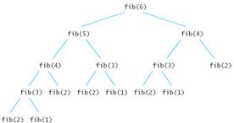
In the recursive code 1, a lot of values are being recalculated multiple times.
Code 2 avoids that.

Slide 12
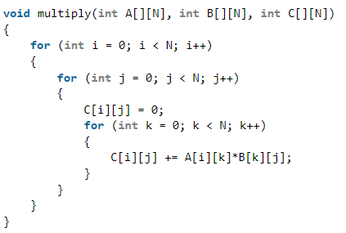
Strassen’s Matrix Multiplication
Traditional Method-
Using this method, two matrices (X and Y) can be multiplied if the order of these matrices are p × q and q × r and the resultant matrix will be of order p × r.
Time Complexity of above method is O(N³).

Slide 13
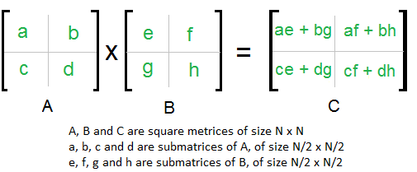
Divide and Conquer-
Divide matrices A and B in 4 sub-matrices of size N/2 x N/2 as shown in the below diagram.
Calculate following values recursively. ae + bg, af + bh, ce + dg and cf + dh.
In the above method, we do 8 multiplications for matrices of size N/2 x N/2 and 4 additions. Addition of two matrices takes O(N2) time. So the time complexity can be written as
T(N) = 8T(N/2) + O(N²)
From Master's Theorem, time complexity of above method is O(N³)
which is unfortunately same as the traditonal method.

Slide 14
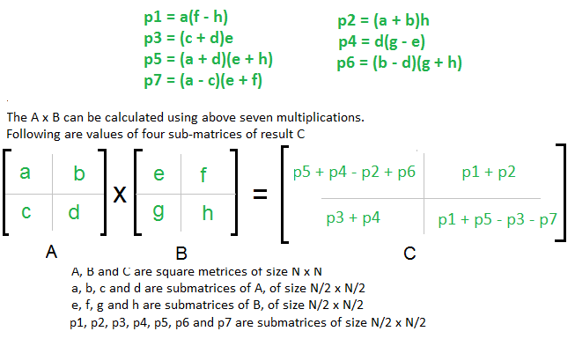
S trassen’s method-
The idea of Strassen’s method is to reduce the number of recursive calls to 7. Strassen’s method is similar to above simple divide and conquer method in the sense that this method also divide matrices to sub-matrices of size N/2 x N/2, but in Strassen’s method, the four sub-matrices of result are calculated using following formulae.

Slide 15
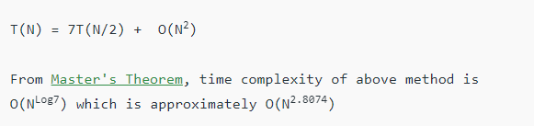
Time Complexity of Strassen’s Method
Addition and Subtraction of two matrices takes O(N2) time. So time complexity can be written as:

Slide 16
Limitations of Strassen’s Matrix Mulitplication
The constants used in Strassen’s method are high and for a typical application Naive method works better.
For Sparse matrices, there are better methods especially designed for them.
The submatrices in recursion take extra space.
Because of the limited precision of computer arithmetic on noninteger values, larger errors accumulate in Strassen’s algorithm than in Naive Method

Slide 17
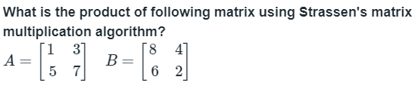
Example

